Slide 1
Age, Gender, and Emotion Detection using Deep Learning
Domain: Deep Learning
Guide:-
Chindukuri Mallikarjuna
Group Members:-
B. Praneeth AP22110010049
P. Venkata Sri Nag AP22110010050
V. Mohan Balu AP22110010057
M. Srihari AP22110010368

Slide 2
Contents
Abstract
Literature Study
Research Gaps
Proposed Methodology
Datasets
Evaluation Metrics
Experimental Results
Conclusion
References

Slide 3
Abstract
Objective: To develop a comprehensive Deep Learning system capable of detecting human faces in real-time and predicting three distinct attributes: Age, Gender, and Emotion.
Approach: The project utilizes Convolutional Neural Networks (CNNs). Three separate models were trained specifically for each task to ensure high modularity and accuracy.
Key Feature: The system integrates Computer Vision (OpenCV) for face detection and Keras/TensorFlow for attribute prediction, converting raw pixels into meaningful demographic and sentimental insights.
Application: Useful in retail analytics (customer profiling), smart signage, and human-computer interaction systems.

Slide 4
Literature Study
S.No | Title | Authors | Journal/Conf | Year | Methodology | Remarks
1 | Age and Gender Prediction using Deep CNNs | R. Rothe et al. | IJCV | 2023 | VGG-16 architecture on IMDB-WIKI | High accuracy but computationally expensive for real-time.
2 | Facial Emotion Recognition using CNN | M. A. H. Akhand | IEEE Access | 2021 | CNN with Data Augmentation on FER2013 | Good performance on static images; struggles with occlusion.
3 | Real-time Age/Gender estimation | K. Zhang et al. | CVPR | 2019 | Multi-task CNN learning | Efficient but accuracy drops in low light.
4 | Age and Gender Classification using Convolutional Neural Networks | G. Levi & T. Hassner | IEEE | 2015 | Simple CNN architecture on Adience | Foundation paper for using CNNs on age/gender tasks.

Slide 5
Research Gaps
Complex Backgrounds: Traditional image processing techniques (like LBP or Gabor filters) fail in cluttered backgrounds or varying lighting conditions.
Feature Engineering: Manual feature extraction is tedious and rarely generalizes well to unseen faces
Real-time Latency: Many deep networks (like ResNet-50 or VGG) are too heavy for real-time CPU-based inference.
Multi-Attribute Dependency: Predicting age, gender, and emotion simultaneously usually requires massive computational power; lightweight custom CNNs are needed to bridge this gap.

Slide 6
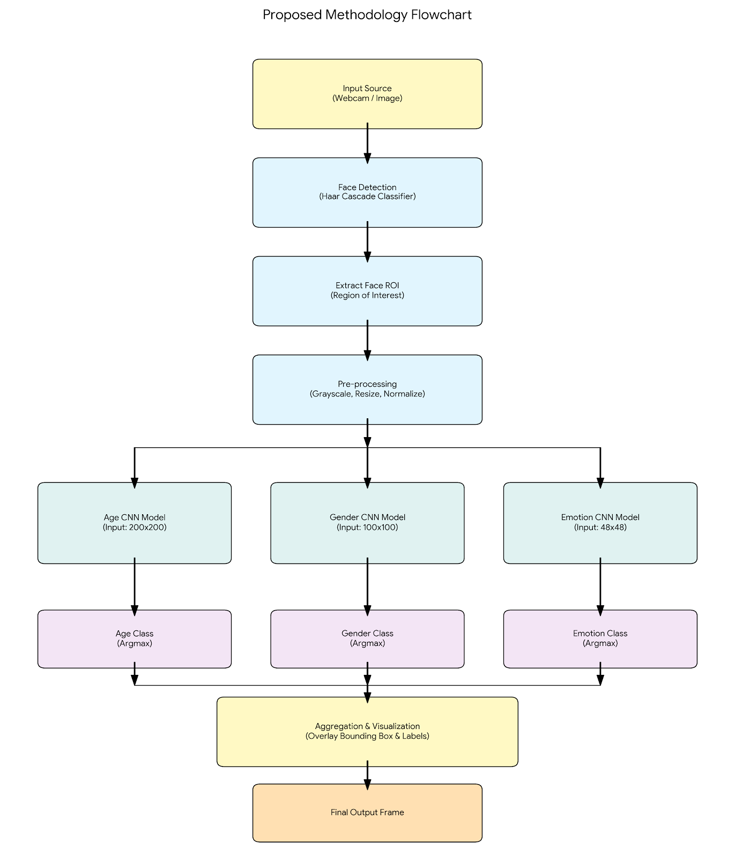
Proposed Methodology (Overview)
Step 1: Image Acquisition: Input image or live video stream.
Step 2: Face Detection: Utilizing Haar Cascade Classifiers (haarcascade_frontalface_default.xml) to isolate faces from the background.
Step 3: Pre-processing:
Grayscale conversion (1 channel).
Resizing (48x48 for Emotion, 100x100 for Gender, 200x200 for Age).
Normalization (Pixel values / 255).
Step 4: Feature Extraction & Classification: Passing the processed ROI (Region of Interest) into three separate trained CNN models.
Step 5: Output Visualization: Overlaying the predicted Age Range, Gender, and Emotion label on the video frame.

Slide 7
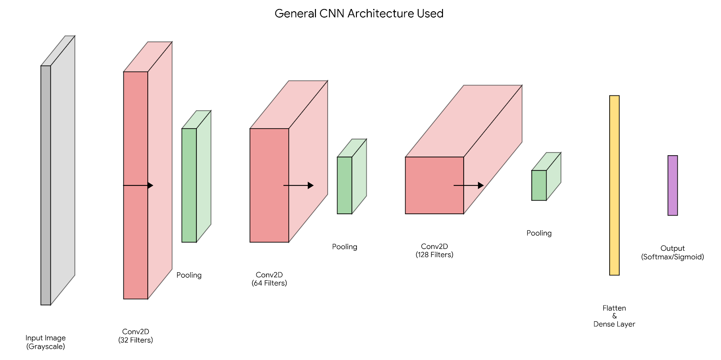
Proposed Methodology CNN Architecture
Input Layers: Tailored input shapes (200x200x1, 100x100x1, 48x48x1).
Convolutional Layers:
Used Conv2D with ReLU activation.
Filter sizes increased progressively: 32 → 64 → 128 → 256.
Kernel size: (3,3) with same padding.
Pooling Strategy:
AgeModel: Used AveragePooling2D and GlobalAveragePooling2D (smoothing features).
Gender/Emotion Models: Used MaxPooling2D (capturing dominant features).
Regularization: Dropout layers (0.1 to 0.2) used to prevent overfitting.
Output Layers:
Gender: Dense(2) with Sigmoid/Softmax.
Emotion: Dense(3) with Sigmoid (Mapped to Positive, Negative, Neutral).
Age: Dense(7) with Softmax (Classified into ranges).

Slide 8

Datasets Details
●Datasets used:
○ Facial-age & UTKFace for Age Detection
○ UTK Faces for Gender Detection
○ CK+48 for Emotion Detection
● Trained Deep Learning CNN Models, for detecting:
○ Age as: '1-2', '3-9', '10-20', '21-27', '28-45', '46-65', '66-116'
○ Gender as: 'male', 'female'
○ Emotion as:
Positive - Happy, Surprise.
Negative - Anger, Sadness.
Neutral - Contempt, Disgust, Fear.
● Split:
75% Training, 25% Testing

Slide 9
Data Pre-processing Steps
Grayscaling: All 3-channel RGB images were converted to 1-channel Grayscale to reduce computational complexity.
Resizing:
Age Model Input: 200×200 pixels.
Gender Model Input: 100×100 pixels.
Emotion Model Input: 48×48 pixels.
Normalization: Pixel intensities scaled from [0, 255] to [0, 1] for faster convergence during training.
Label Encoding:
Age: Binning into 7 classes: ['1-2', '3-9', '10-20', '21-27', '28-45', '46-65', '66-116'].
Gender: Binary encoding (0: Male, 1: Female).
Emotion: One-hot encoding of 3 classes.

Slide 10
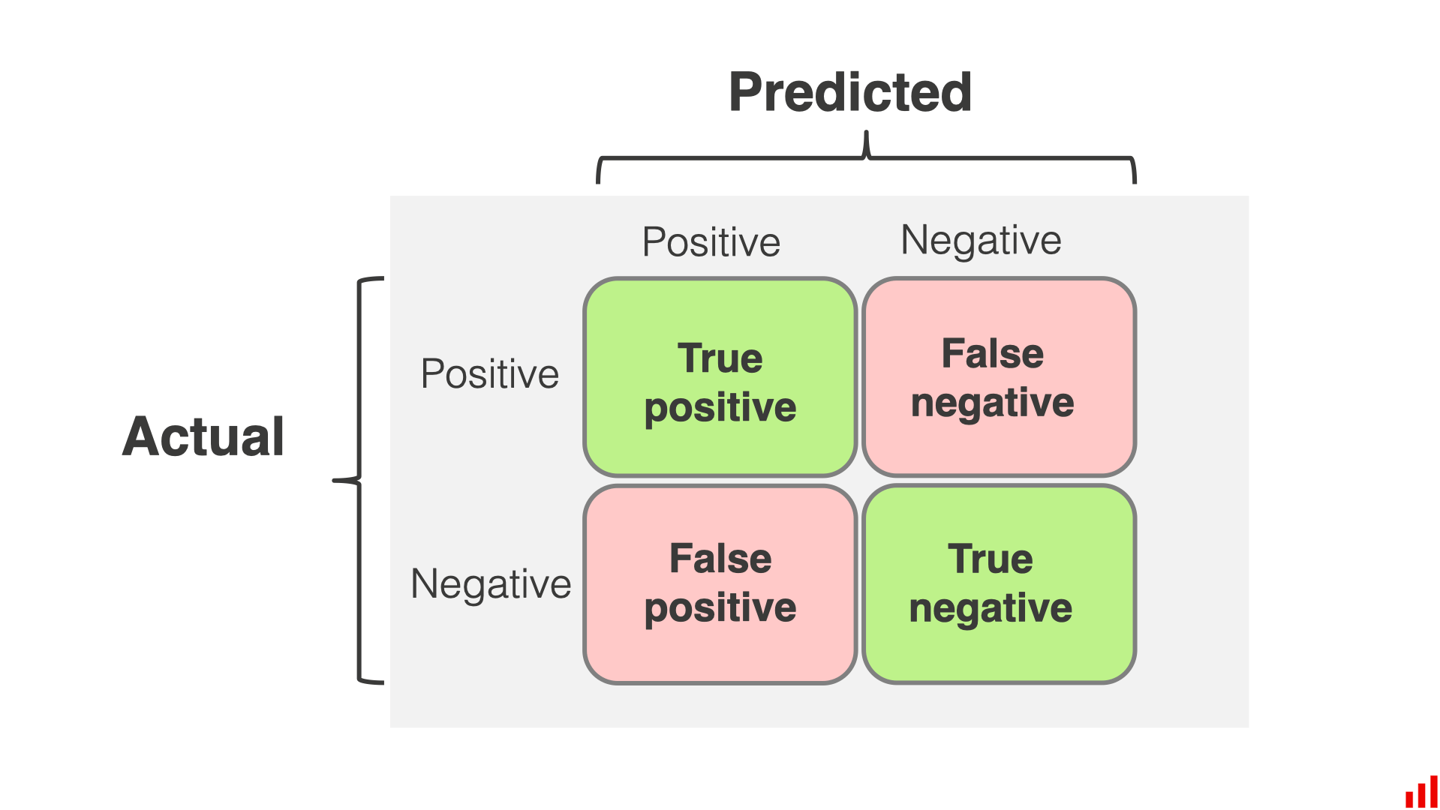
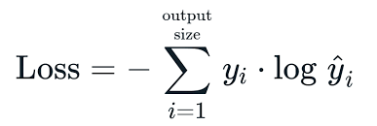
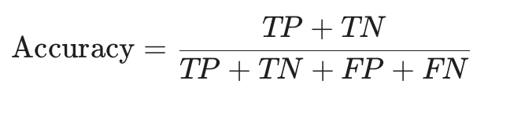
Evaluation Metrics
Accuracy: The ratio of correctly predicted observations to the total observations.
Loss Function:
Categorical Crossentropy: Used for Age and Emotion (Multi-class classification).
Sparse Categorical Crossentropy: Used for Gender (Binary classification).
Confusion Matrix: To analyze the performance of specific classes (e.g., confusing "Fear" with "Surprise").

Slide 11
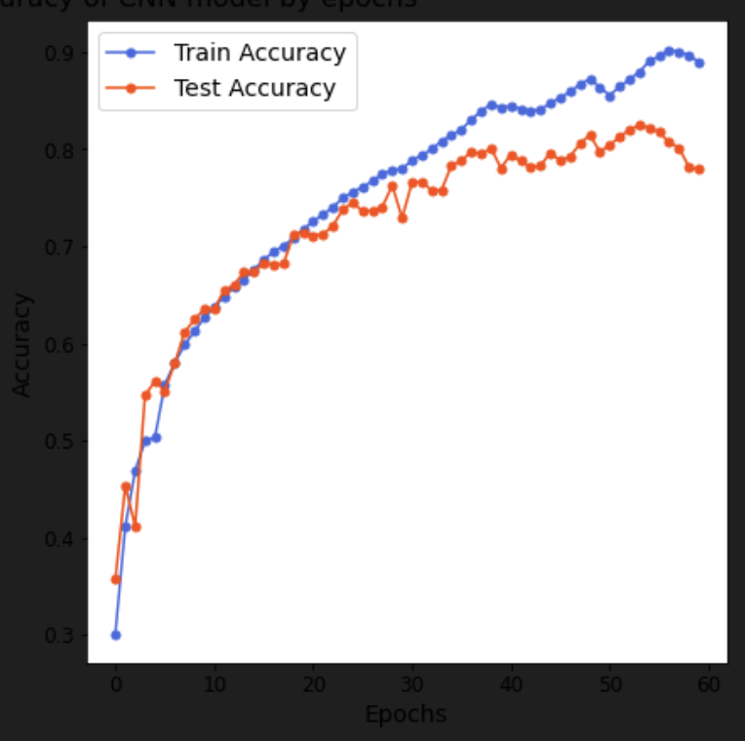
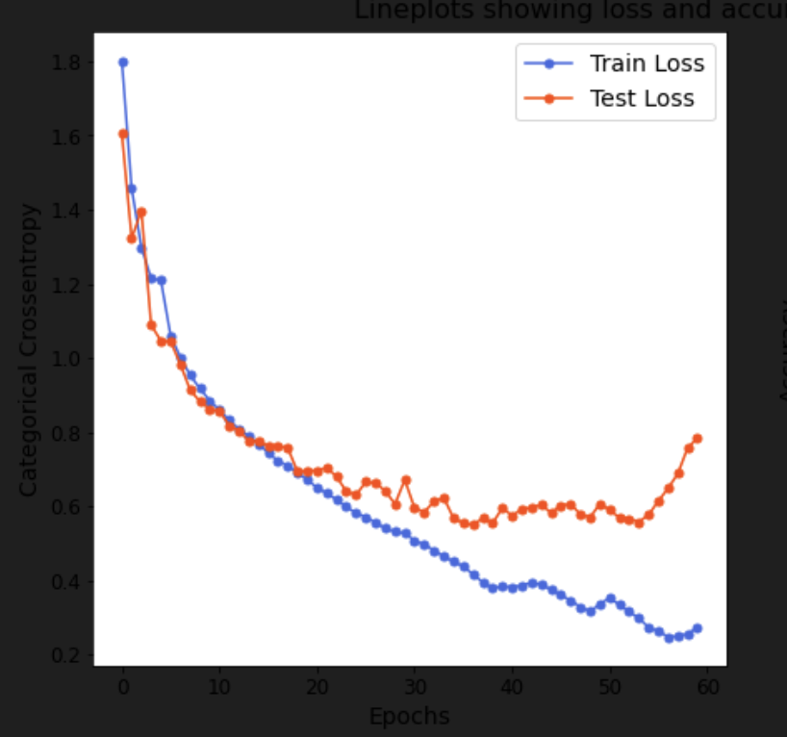
Experimental Results - Age Prediction
Training Config: 60 Epochs, Batch Size 512.
Model Complexity: ~422,000 Trainable parameters.
Performance:
Training Accuracy achieved: ~90%
Validation Accuracy achieved: ~78-80%
Observation: The model performs well on adults (21-65) but faces slight difficulty distinguishing between very adjacent classes (e.g., 21-27 vs 28-45) due to visual similarities.

Slide 12
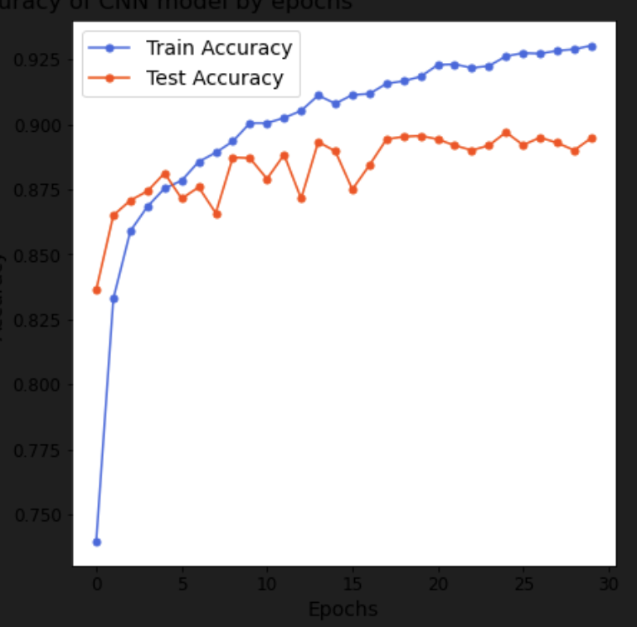
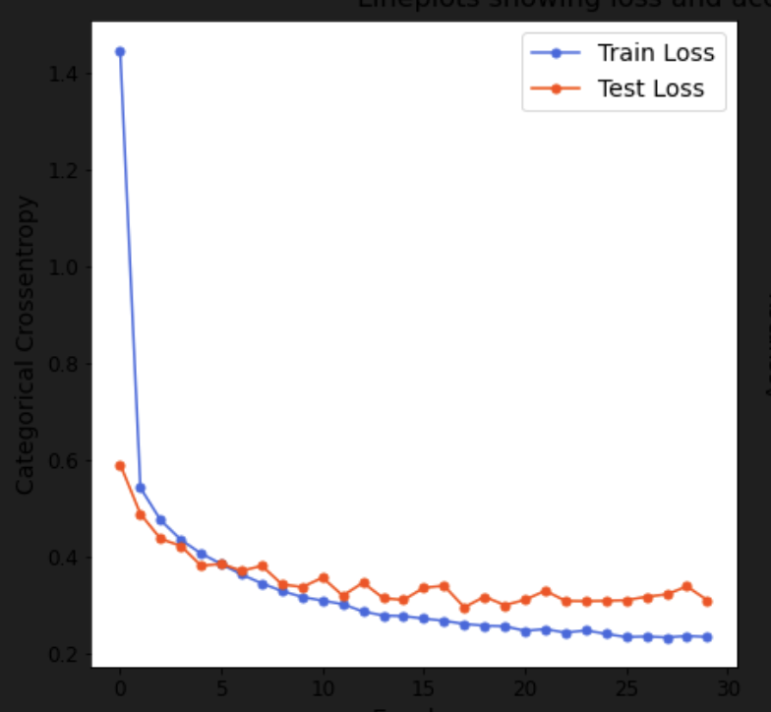
Experimental Results - Gender Prediction
Training Config: 30 Epochs.
Model Complexity: ~1.5 Million Trainable parameters (Larger dense layers).
Performance:
Training Accuracy: ~93%
Validation Accuracy: ~89%
Observation: The model converged quickly (within 15 epochs). The use of MaxPooling helped in extracting sharp features like jawline and hair texture which differ between genders.

Slide 13
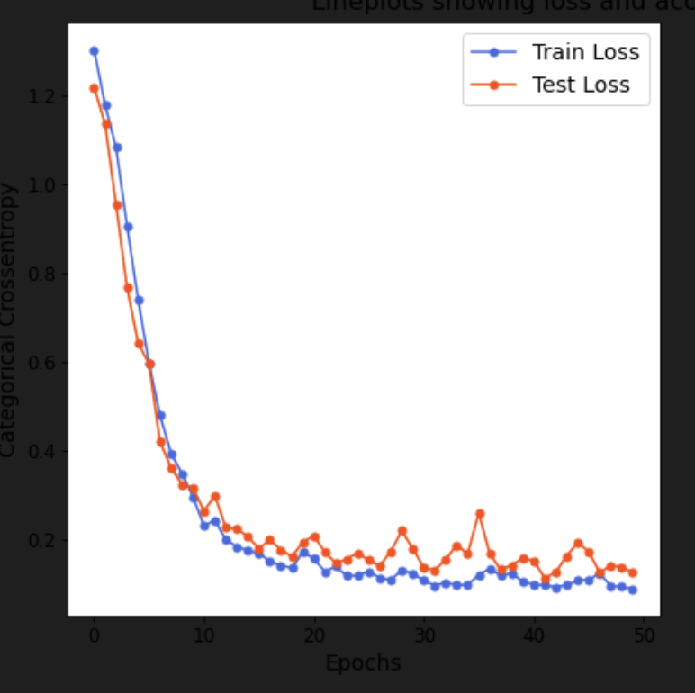
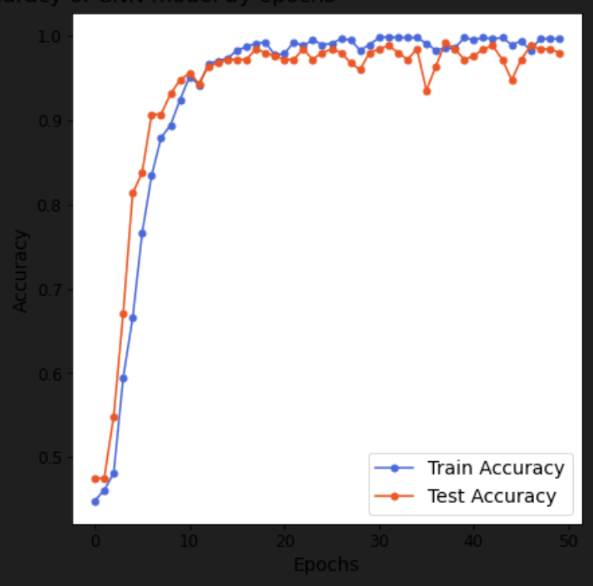
Experimental Results - Emotion Detection
Training Config: 50 Epochs, Batch Size 32.
Model Complexity: ~683,000 Trainable parameters.
Performance:
Training Accuracy: ~99%
Validation Accuracy: ~98%
Observation: Grouping emotions into "Positive/Negative/Neutral" significantly boosted accuracy compared to predicting 7 distinct micro-expressions, making the system more robust for real-world retail scenarios.

Slide 14
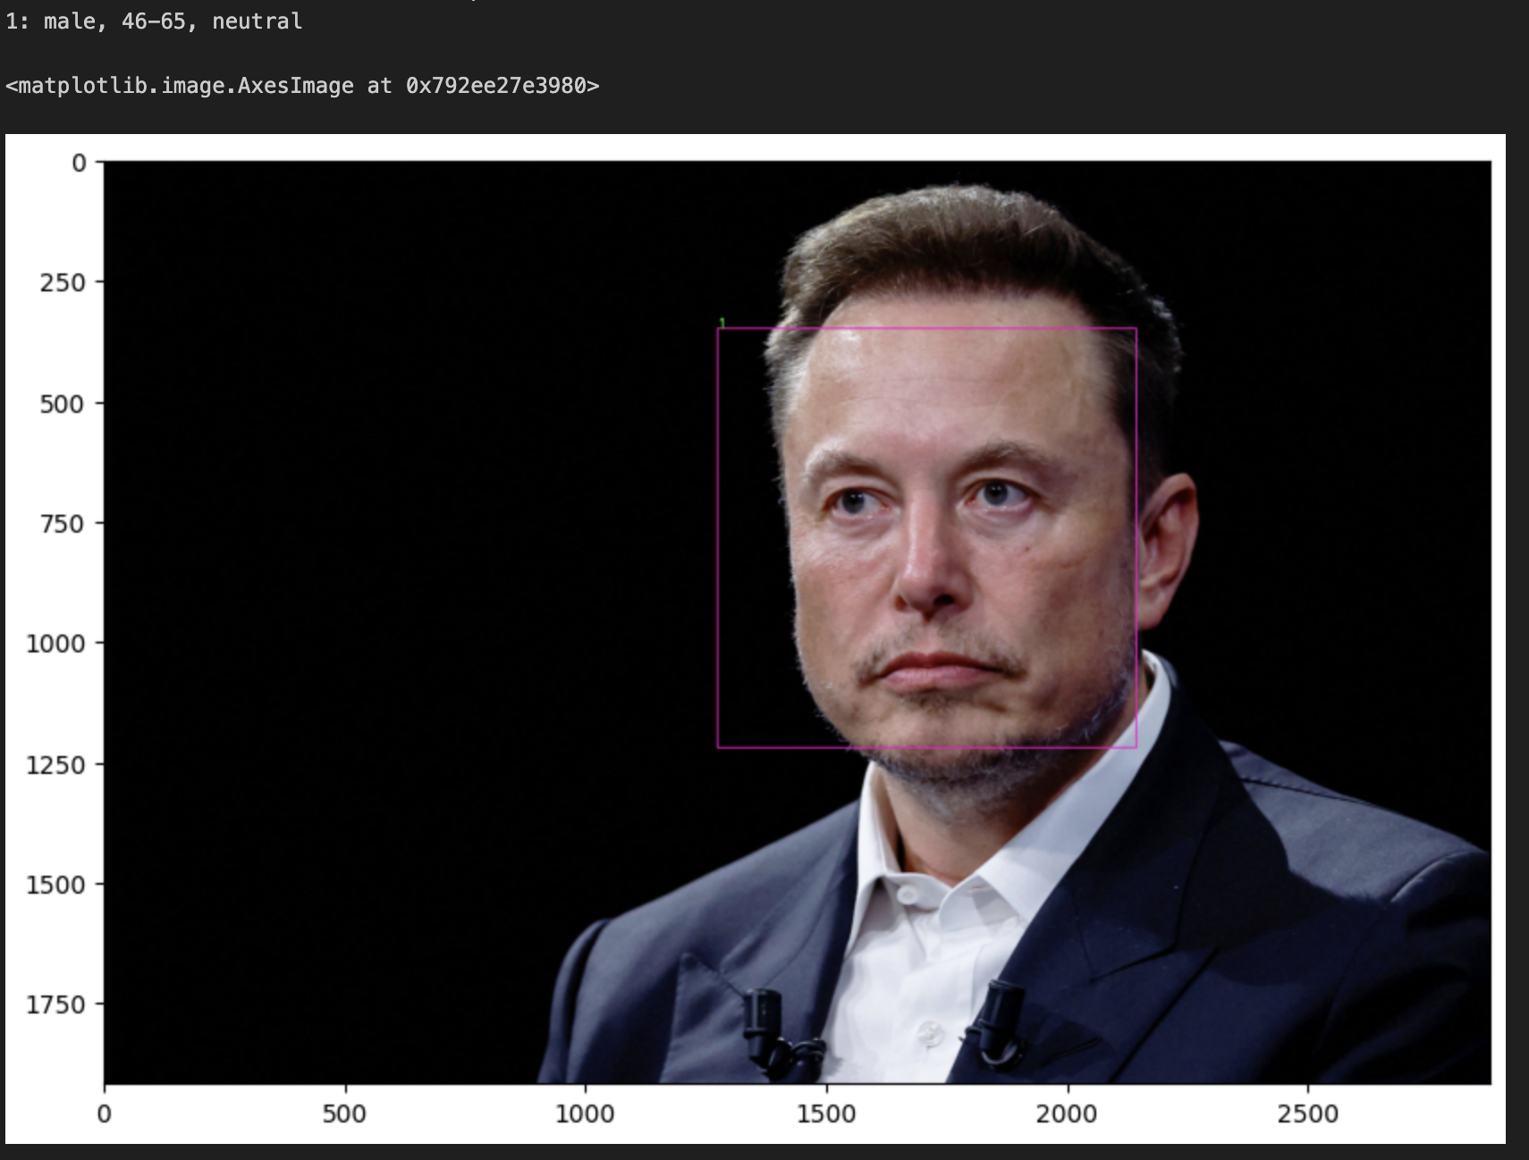
Real-time Prediction Module
Implementation: The final module (3.1_Pred_Final.ipynb) loads the three saved .h5 models.
Workflow:
Capture frame from Webcam.
Detect Face using Haar Cascade.
Extract Face ROI (Region of Interest).
Resize ROI 3 times (for Age, Gender, Emotion inputs).
Pass through respective models.
np.argmax() extracts the class with highest probability.
Draw bounding box and label text using cv2.putText.

Slide 15
Conclusion
We successfully designed and implemented a deep learning system for demographic and sentiment analysis.
Key Achievements:
  Built a lightweight Age model using Global Average Pooling.
  Achieved high accuracy on Emotion detection by simplifying class labels.
  Integrated all three models into a single real-time prediction pipeline.
The system demonstrates that CNNs can effectively extract high-level facial features without manual descriptor calculation (like LBP or HOG).

Slide 16
Future Scope
Dataset Expansion: Train on datasets with more ethnic diversity to reduce bias.
Architecture: Implement Transfer Learning using MobileNetV2 to further reduce model size for mobile deployment.
Micro-expressions: Expand the Emotion model back to 7 classes using attention mechanisms to detect subtle emotions like "Contempt".

Slide 17
References
Rothe, R., Timofte, R., & Van Gool, L. (2018). Deep expectation of real and apparent age from a single image without facial landmarks. International Journal of Computer Vision.
Levi, G., & Hassner, T. (2015). Age and gender classification using convolutional neural networks. IEEE Conference on Computer Vision and Pattern Recognition (CVPR).
Zhang, K., & Gao, Y. (2019). Joint Age and Gender Classification.
Keras Documentation: https://keras.io/
UTKFace Dataset: https://www.kaggle.com/datasets/jangedoo/utkface-new

Slide 18
Thank you

